Slide 1



Scala
For “Scale-able” data

Slide 2


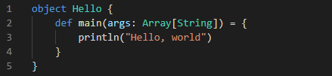
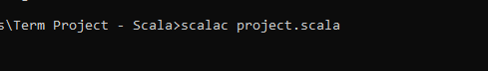

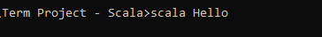
Scala Basics
Numbers
Compiled language
Interpreted using the JVM
Strongly object-oriented and very functional, because…
In CMD:
- “scalac” to compile
- “scala” to run
Strings
All*
Data
Is
Immutable
Tuples
Vars
Vals
(kind of)*
Notes:
Scala is compiled into class files
Each object in the Scala program is given a separate two class files based on name
When you call “scala” in the command line (or elsewhere), it looks for a class file with the given name in the working directory and runs the main method of that class
This somewhat unique method of calling makes scala easy to slap into a java program, or just about any program, with just a couple data files and a process
Hello$.class contains info about the class structure and often implicit data needed by the class,
Hello.class contains info about the class’s actual methods and data (both are needed)

Slide 3
Overall: C++ and Scala
C++
Scala
Object - Oriented Programming
Minor Functional Aspects
Control of data
Low Level Programming
Object - Oriented Programming
99% Functional
Data Powerhouse
Surprisingly High Level

Slide 4
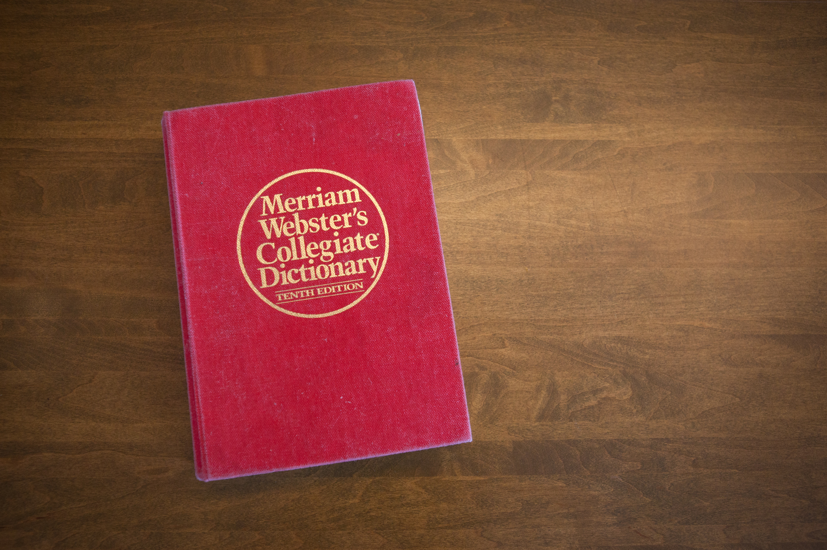
The Project:
The ultimate battle of Scala Vs C++

Slide 5

A Dictionary
Merriam-Webster (.json)
100,000+ entries
~20 MB
Goal:
- Read into program
- Test some speeds
- Compare

Slide 6
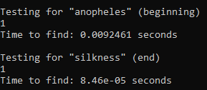
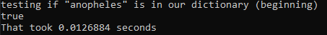
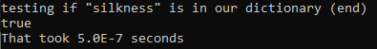
C++
Scala
We’ll look at this later*

